Slide 1
Introduction to Statistical Methods(ISM)

Slide 2
Session 9
(04th July 2026)
Testing of Hypothesis

Slide 3
Agenda
Testing of Hypothesis based on mean
Testing of Hypothesis based on Proportion
Chi-square test

Slide 4
Need for Testing of Hypothesis
Validate Assumptions: To check whether the assumptions made about a population or process are statistically valid.
Support Decision-Making: Helps in making objective decisions based on data rather than intuition or guesswork.
Determine Statistical Significance: Evaluates whether the observed effect or relationship is due to chance or is statistically significant.

Slide 5
A statistical rule which decides whether to accept or reject the null hypothesis on the basis of data
Types of statistical test
Parametric tests
Non-parametric tests
Based on the assumption of some probability distribution
Not based on any assumption of probability distribution

Slide 6
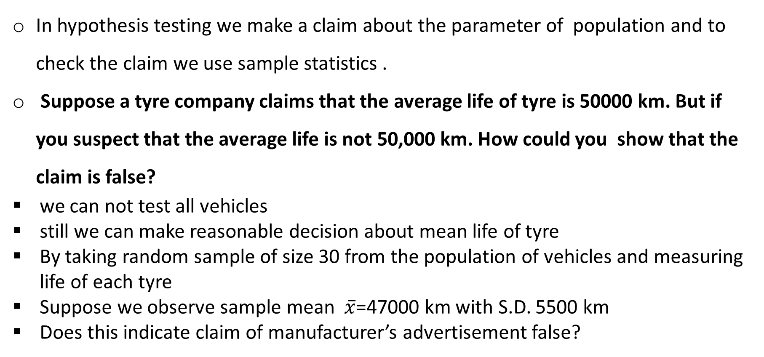
Testing of Hypothesis
In hypothesis testing we make a claim about the parameter of population and to check the claim we use sample statistics .
Suppose a tyre company claims that the average life of tyre is 50000 km. But if you suspect that the average life is not 50,000 km. How could you show that the claim is false?
we can not test all vehicles
still we can make reasonable decision about mean life of tyre
By taking random sample of size 30 from the population of vehicles and measuring life of each tyre
Suppose we observe sample mean $\overline{x}$=47000 km with S.D. 5500 km
Does this indicate claim of manufacturer’s advertisement false?

Slide 7
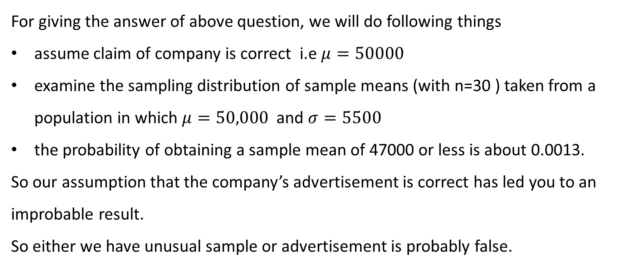
Testing of Hypothesis
For giving the answer of above question, we will do following things
assume claim of company is correct i.e $μ=50000$
examine the sampling distribution of sample means (with n=30 ) taken from a population in which $μ=50,000$ and $σ=5500$
the probability of obtaining a sample mean of 47000 or less is about 0.0013.
So our assumption that the company’s advertisement is correct has led you to an improbable result.
So either we have unusual sample or advertisement is probably false.

Slide 8

Testing of Hypothesis
Null Hypothesis$H_{0}$: A statement about population parameter that contains a statement of equality such as $≤, =$ or $≥$
Alternative Hypothesis $H_{a}$: It is the complement of Null hypothesis. It contains a statement of strict inequality such as $>, ≠, <.$
Write the null hypothesis and alternative hypothesis and identify which
represents the claim.
A school publicizes that proportion of its students who are involved in at least one extracurricular activity is 61%.
A car dealership announces that the mean time for an oil change is less than 15 mins.
A company advertises that the mean life of its furnace is more than 18 years.

Slide 9
Errors
Our decision is based on sample rather than entire population
there is always possibility we will make the wrong decision
Suppose we claim that a certain coin is not fair. To test your claim, we flip the coin 100 times and get 49 heads and 51 tails suppose we claim that a certain coin is not fair. You would probably agree that you do not have enough evidence to support your claim even though it is possible that the coin is actually not fair. In such situations errors are occurred.
There are two types of errors :
Type I error: Occurs if the null hypothesis is rejected when it is true .
Type II error: Null hypothesis is not rejected when it is false.

Slide 10
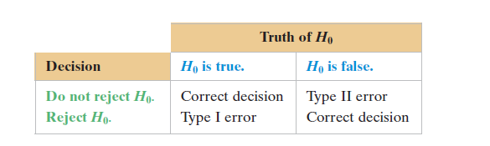
Type of Errors

Slide 11
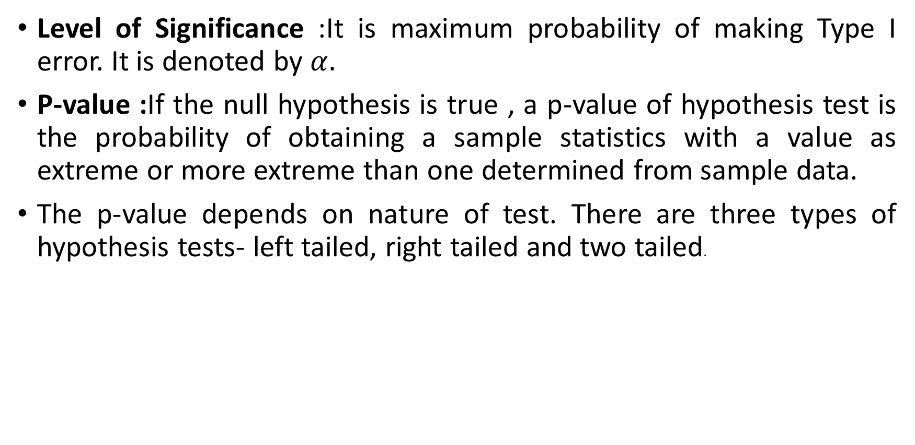
Level of Significance and $p−value$
Level of Significance :It is maximum probability of making Type I error. It is denoted by $α.$
P-value :If the null hypothesis is true , a p-value of hypothesis test is the probability of obtaining a sample statistics with a value as extreme or more extreme than one determined from sample data.
The p-value depends on nature of test. There are three types of hypothesis tests- left tailed, right tailed and two tailed.

Slide 12
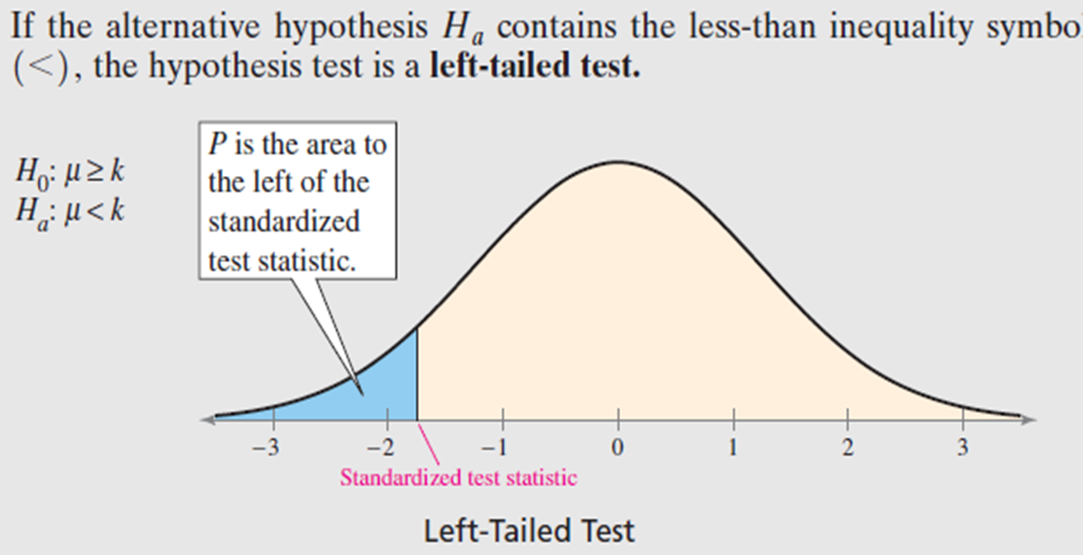
Left Tailed Test
.

Slide 13
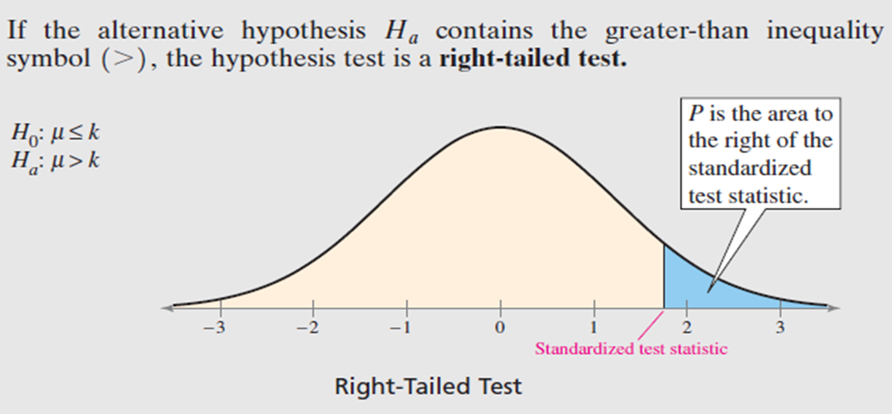
Right Tailed test
.

Slide 14
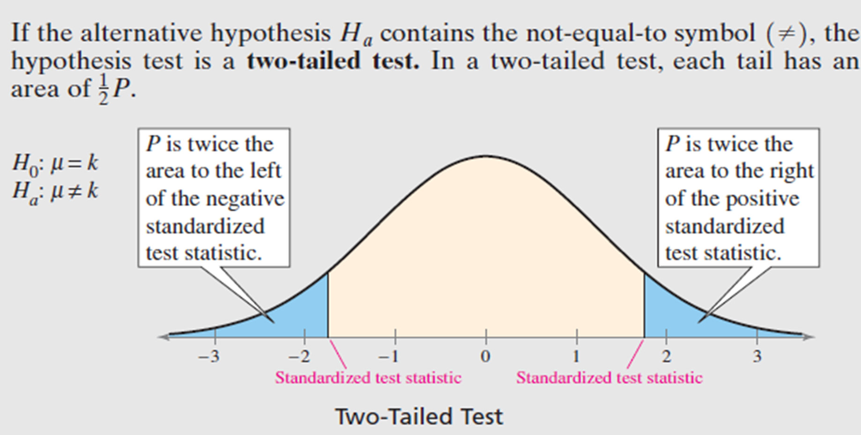
Two-Tailed Test
.

Slide 15
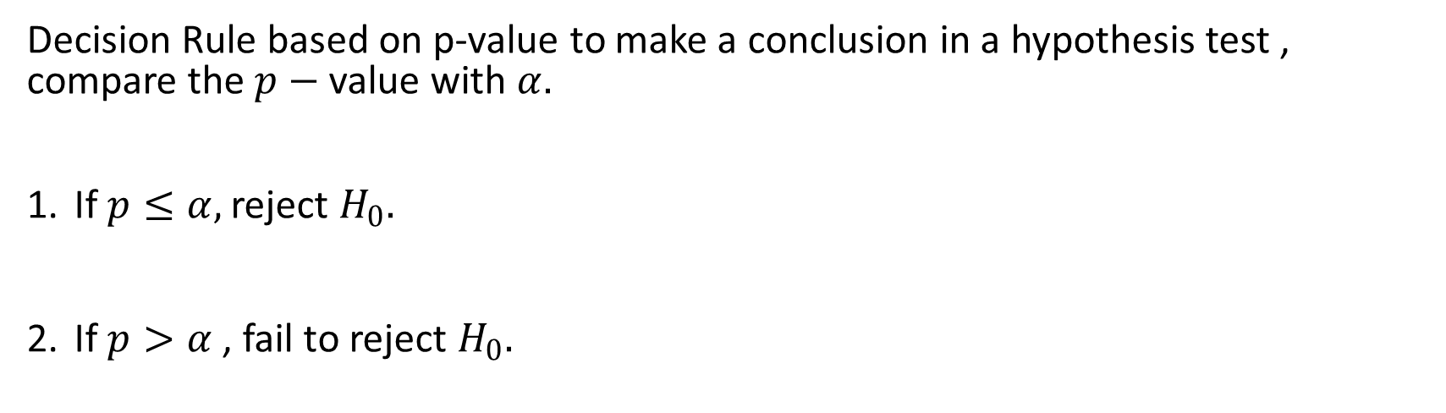
Decision Rule based on p-value
Decision Rule based on p-value to make a conclusion in a hypothesis test , compare the $p−$ value with $α.$
If $p≤α,$ reject $H_{0}.$
If $p>α$ , fail to reject $H_{0}.$

Slide 16
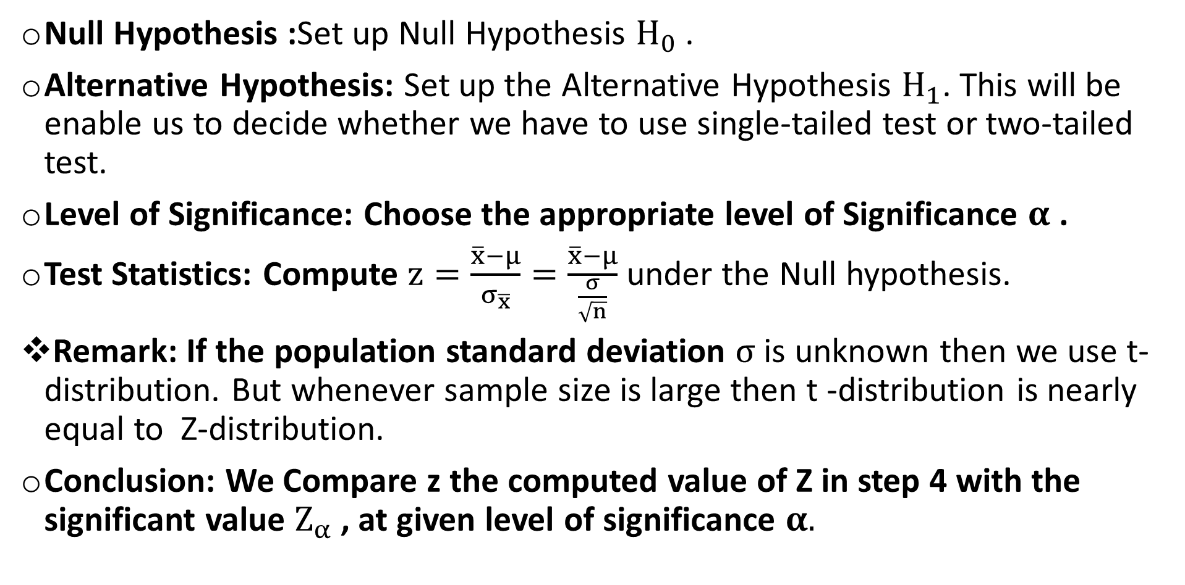
Procedure for Testing of Hypothesis (for single mean):
Null Hypothesis :Set up Null Hypothesis $H_{0}$ .
Alternative Hypothesis: Set up the Alternative Hypothesis $H_{1}$. This will be enable us to decide whether we have to use single-tailed test or two-tailed test.
Level of Significance: Choose the appropriate level of Significance $α$ .
Test Statistics: Compute $z=\frac{\overline{x}−μ}{σ_{\overline{x}}}=\frac{\overline{x}−μ}{\frac{σ}{\sqrt{n}}}$ under the Null hypothesis.
Remark: If the population standard deviation $σ$ is unknown then we use t-distribution. But whenever sample size is large then t -distribution is nearly equal to Z-distribution.
Conclusion: We Compare z the computed value of Z in step 4 with the significant value $Z_{α}$ , at given level of significance $α.$

Slide 17
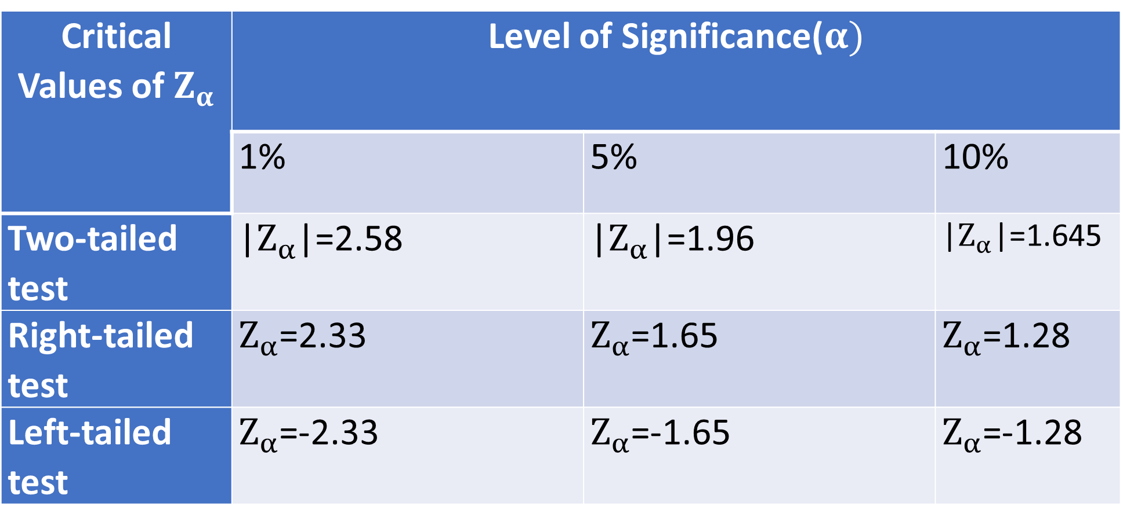

Level of Significance($α)$
.

Slide 18
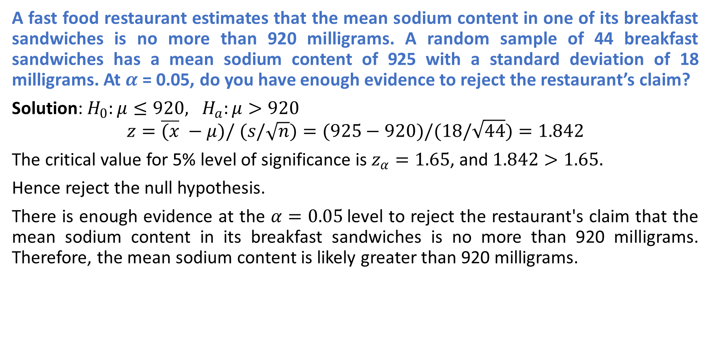
Example
A fast food restaurant estimates that the mean sodium content in one of its breakfast sandwiches is no more than 920 milligrams. A random sample of 44 breakfast sandwiches has a mean sodium content of 925 with a standard deviation of 18 milligrams. At $α$ = 0.05, do you have enough evidence to reject the restaurant’s claim?
Solution: $H_{0}:μ≤920, H_{a}:μ>920$
$$z=\overline{(x} −μ)/ (s/\sqrt{n})=(925−920)/(18/\sqrt{44})=1.842$$
The critical value for 5% level of significance is $z_{α}=1.65$, and $1.842>1.65.$
Hence reject the null hypothesis.
There is enough evidence at the $α=0.05$level to reject the restaurant's claim that the mean sodium content in its breakfast sandwiches is no more than 920 milligrams. Therefore, the mean sodium content is likely greater than 920 milligrams.

Slide 19
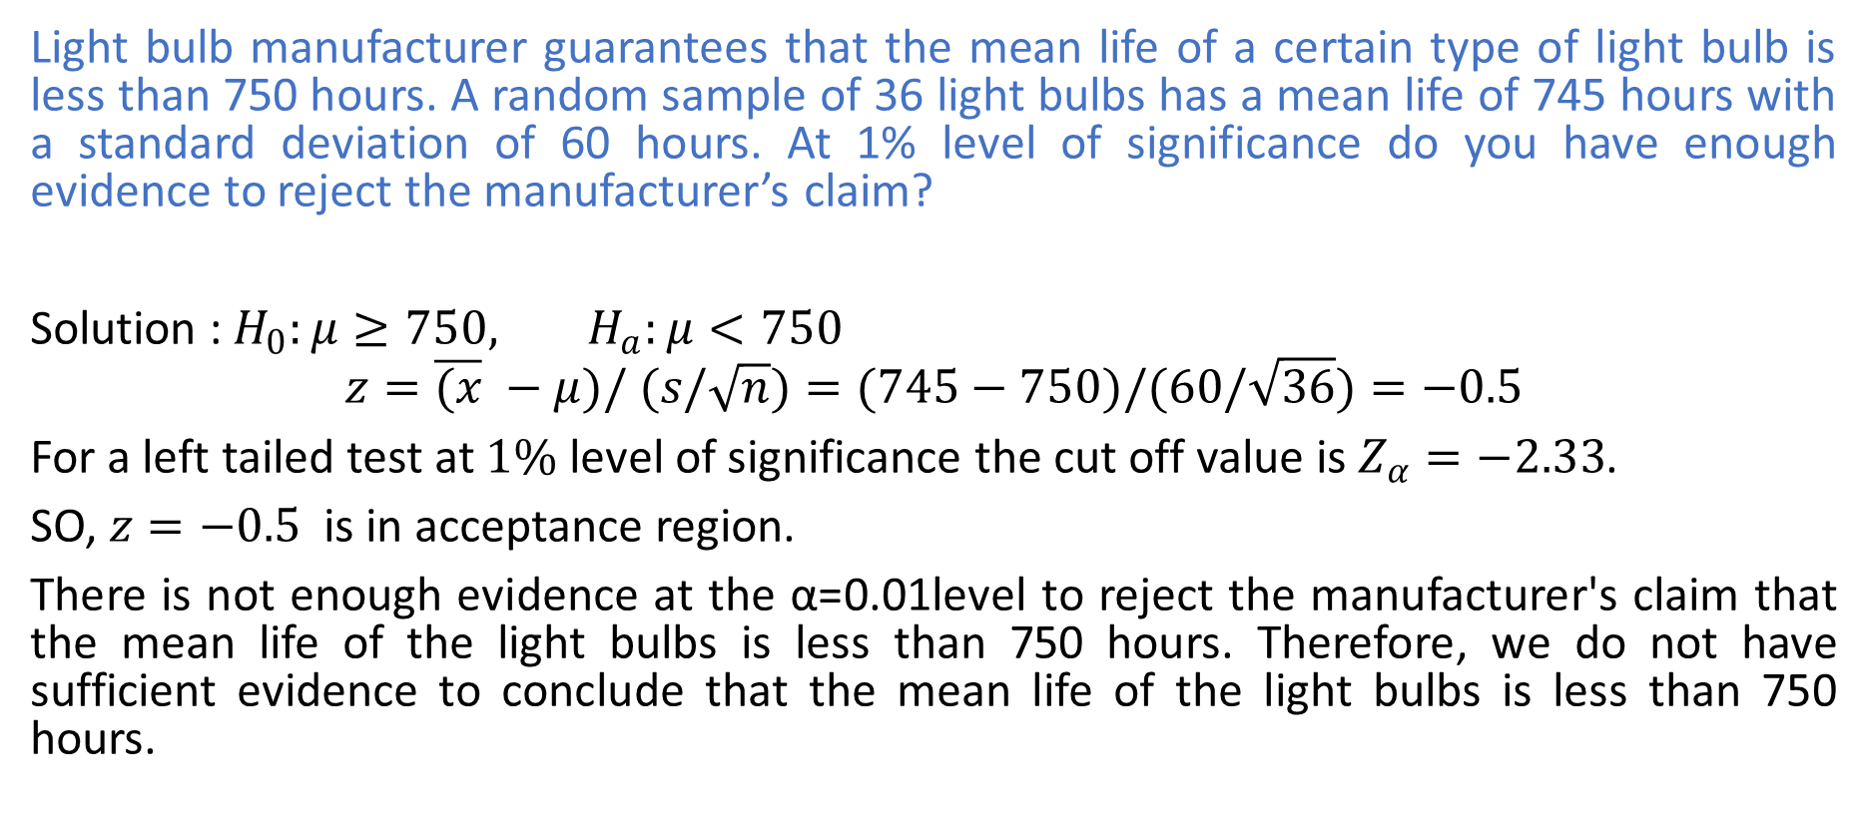
Example
Light bulb manufacturer guarantees that the mean life of a certain type of light bulb is less than 750 hours. A random sample of 36 light bulbs has a mean life of 745 hours with a standard deviation of 60 hours. At 1% level of significance do you have enough evidence to reject the manufacturer’s claim?
Solution : $H_{0}:μ≥750, H_{a}:μ<750$
$$z=\overline{(x} −μ)/ (s/\sqrt{n})=(745−750)/(60/\sqrt{36})=−0.5$$
For a left tailed test at $1\%$ level of significance the cut off value is $Z_{α}=−2.33$.
SO, $z=−0.5$ is in acceptance region.
There is not enough evidence at the α=0.01level to reject the manufacturer's claim that the mean life of the light bulbs is less than 750 hours. Therefore, we do not have sufficient evidence to conclude that the mean life of the light bulbs is less than 750 hours.

Slide 20
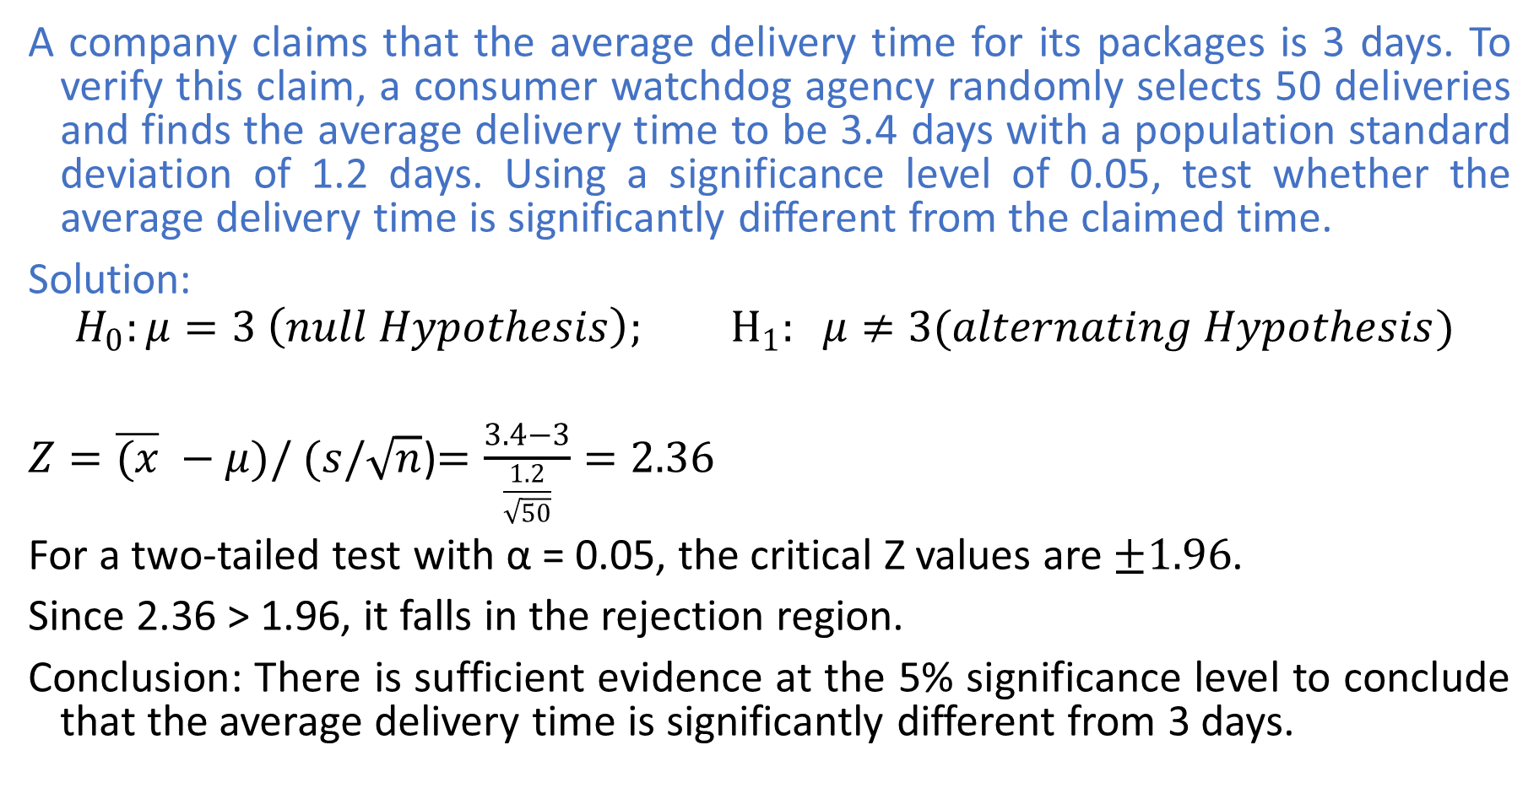
Example
A company claims that the average delivery time for its packages is 3 days. To verify this claim, a consumer watchdog agency randomly selects 50 deliveries and finds the average delivery time to be 3.4 days with a population standard deviation of 1.2 days. Using a significance level of 0.05, test whether the average delivery time is significantly different from the claimed time.
Solution:
$$H_{0}:μ=3 \left(null Hypothesis\right); H_{1}: μ≠3(alternating Hypothesis)$$
$Z=\overline{(x} −μ)/ (s/\sqrt{n}$)$=\frac{3.4−3}{\frac{1.2}{\sqrt{50}}}=2.36$
For a two-tailed test with α = 0.05, the critical Z values are$±1.96$.
Since 2.36 > 1.96, it falls in the rejection region.
Conclusion: There is sufficient evidence at the 5% significance level to conclude that the average delivery time is significantly different from 3 days.

Slide 21
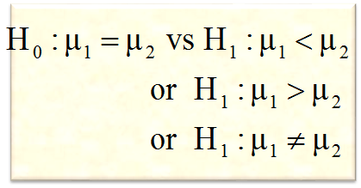
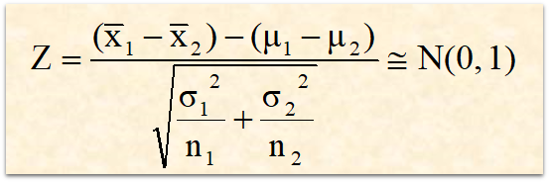
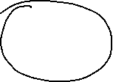
Parametric tests: Z-test for testing (µ₁ - µ₂)
.
1
State null and alternative hypothesis
2
Specify the level of significance ‘α’
3
Standard Normal Distribution
4
Compute the test statistic
5
Define the critical region/ rejection criteria
6
Conclusion
Note: Assuming population variances are known

Slide 22
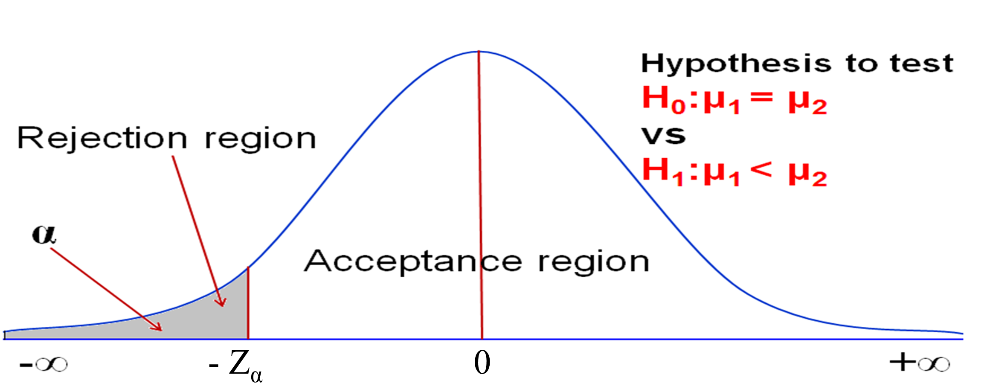
Parametric Tests
.
5
Define the critical region/ rejection criteria/ P - value
(i)
Reject H₀, if computed value of Z is less than the critical value, ie., P(Z < -z_{α}), otherwise do not reject H₀
6
Conclusion

Slide 23
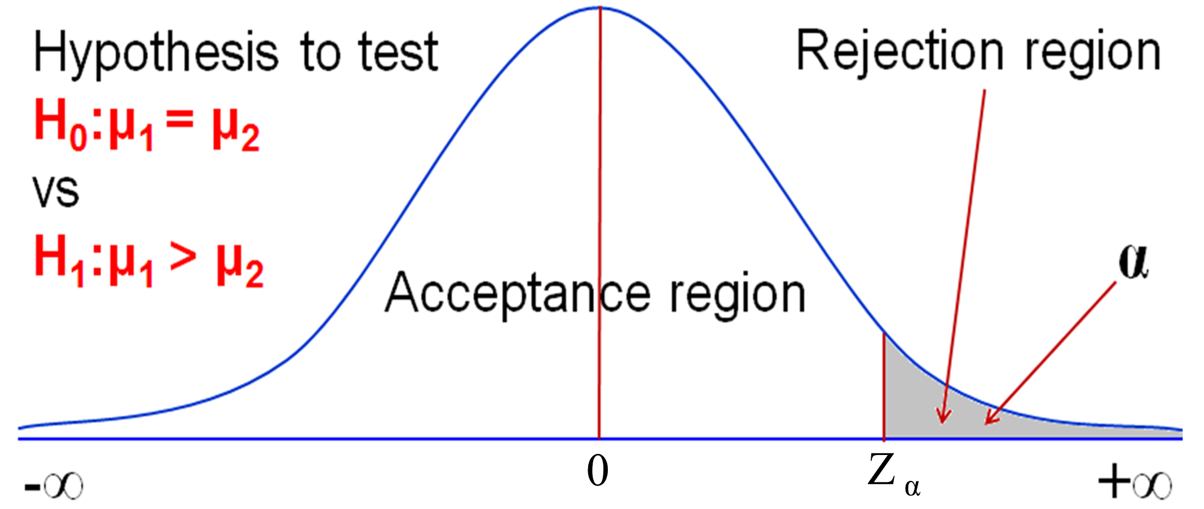
Parametric Tests
.
5
Define the critical region/ rejection criteria/ P - value
(ii)
Reject H₀, if computed value of Z is greater than the critical value, ie., P(Z > z_{α}), otherwise do not reject H₀
6
Conclusion

Slide 24
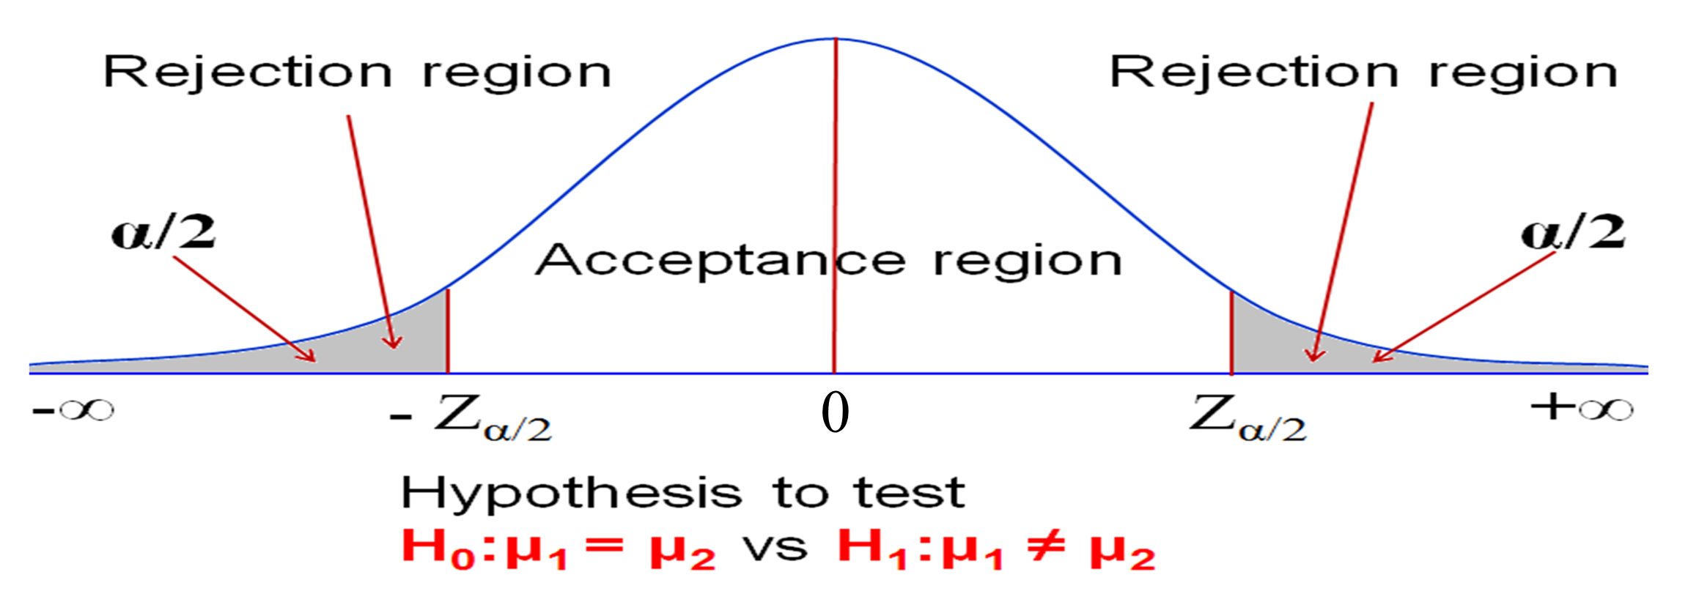
Parametric Tests
5
Define the critical region/ rejection criteria/ P - value
.
(iii)
Reject H₀, if computed value of Z is less than or greater than the critical value, ie., P(Z < - z_{α/2}) or P(Z > z_{α/2}), otherwise do not reject H₀
6
Conclusion

Slide 25
Example 1:
A taxi company is trying to decide whether to purchase brand A or brand B tyres for its fleet of taxis. To estimate difference in two brands, an experiment was conducted using 30 and 40 tyres respectively for brand A and brand B. The tyres are run until they wear out.
Test at 5% level of significance is there any significant difference between the two brands of tyres
Suppose some data is given below, now how will you decide to purchase the brand?
Brands | Sample size | Mean(kms) | SD(kms)
A | 30 | 38600 | 5000
B | 40 | 35450 | 6100

Slide 26


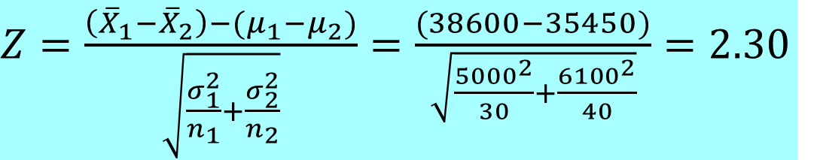
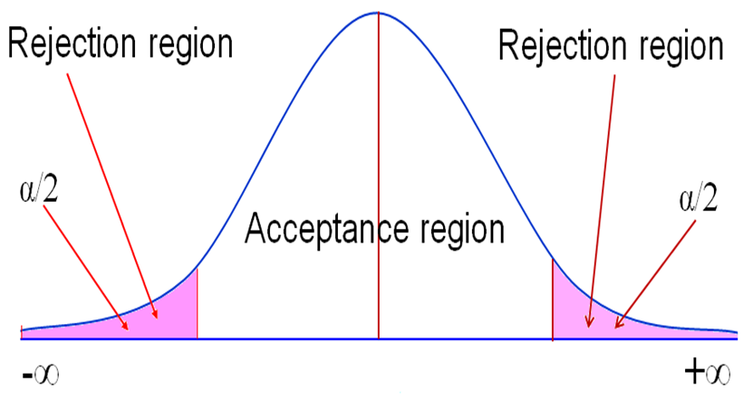
Solution
Critical value for α = 0.05 is 1.96.
Since Z = 2.30 > 1.96,
Reject H_{0,} Don’t reject H₁
Z_{α}= - 1.96
Z_{α}= 1.96

Slide 27
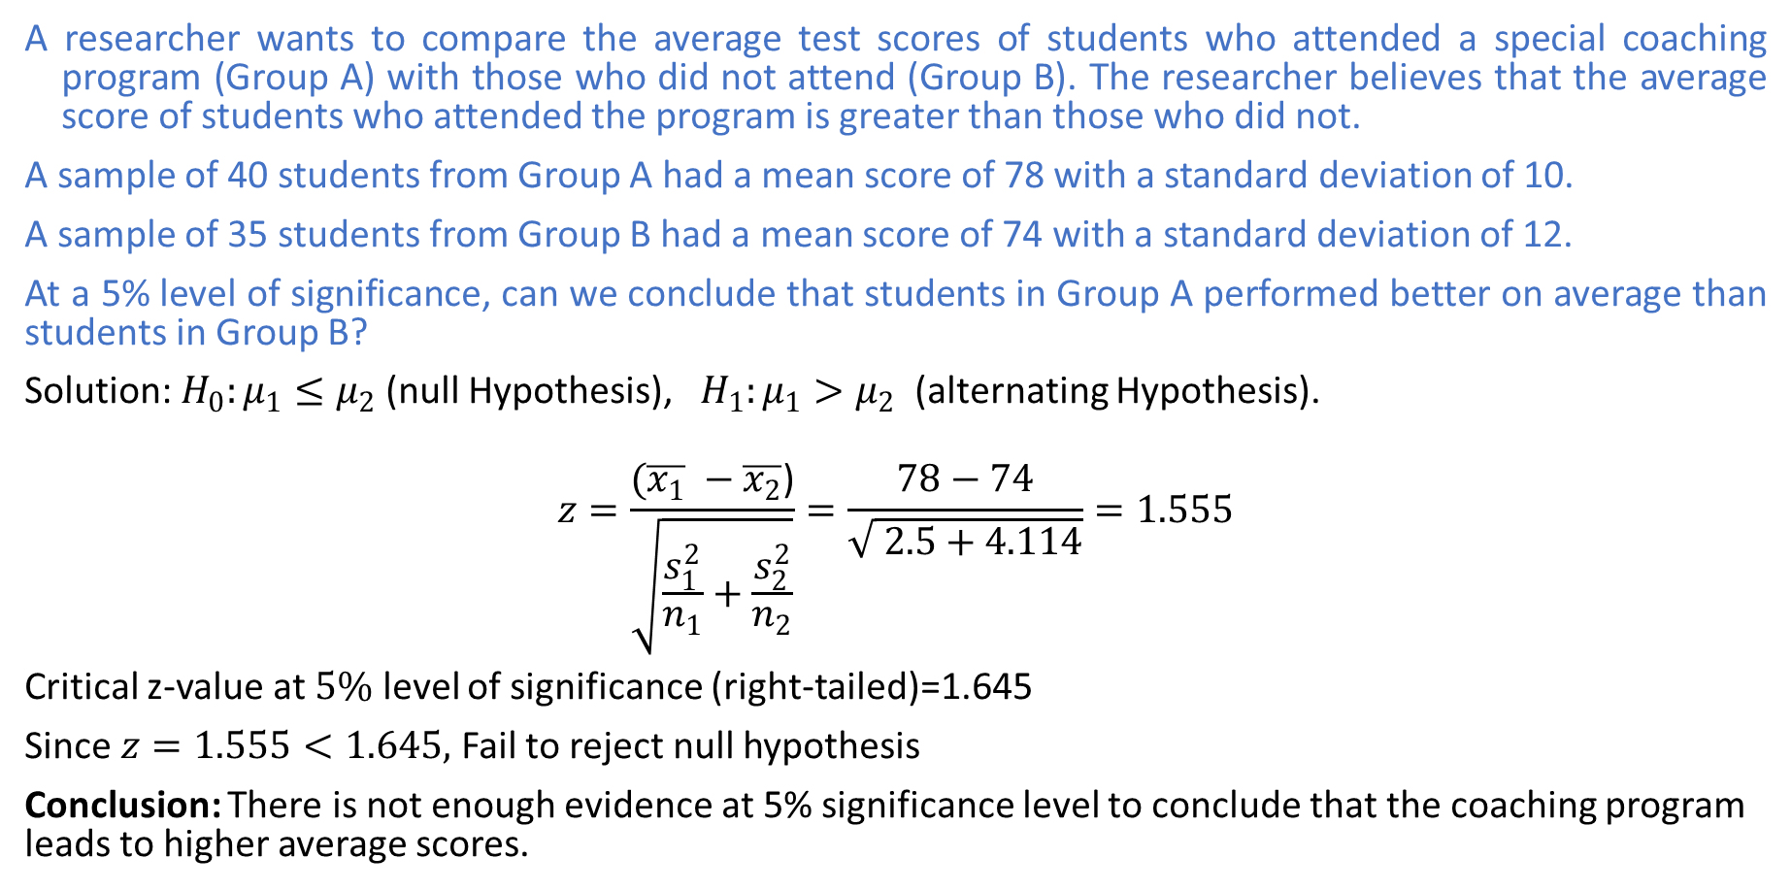
Example 2
A researcher wants to compare the average test scores of students who attended a special coaching program (Group A) with those who did not attend (Group B). The researcher believes that the average score of students who attended the program is greater than those who did not.
A sample of 40 students from Group A had a mean score of 78 with a standard deviation of 10.
A sample of 35 students from Group B had a mean score of 74 with a standard deviation of 12.
At a 5% level of significance, can we conclude that students in Group A performed better on average than students in Group B?
Solution: $H_{0}:μ_{1}≤μ_{2}$(null Hypothesis), $H_{1}:μ_{1}>μ_{2}$ (alternating Hypothesis).
$$z=\frac{(\overline{x_{1}} −\overline{x_{2}}\text{)}}{\sqrt{\frac{s_{1}^{2}}{n_{1}}+\frac{s_{2}^{2}}{n_{2}}}}=\frac{78−74}{\sqrt{ 2.5+4.114}}=1.555$$
Critical z-value at $5\%$ level of significance (right-tailed)=1.645
Since $z=1.555<1.645,$ Fail to reject null hypothesis
Conclusion: There is not enough evidence at 5% significance level to conclude that the coaching program leads to higher average scores.

Slide 28






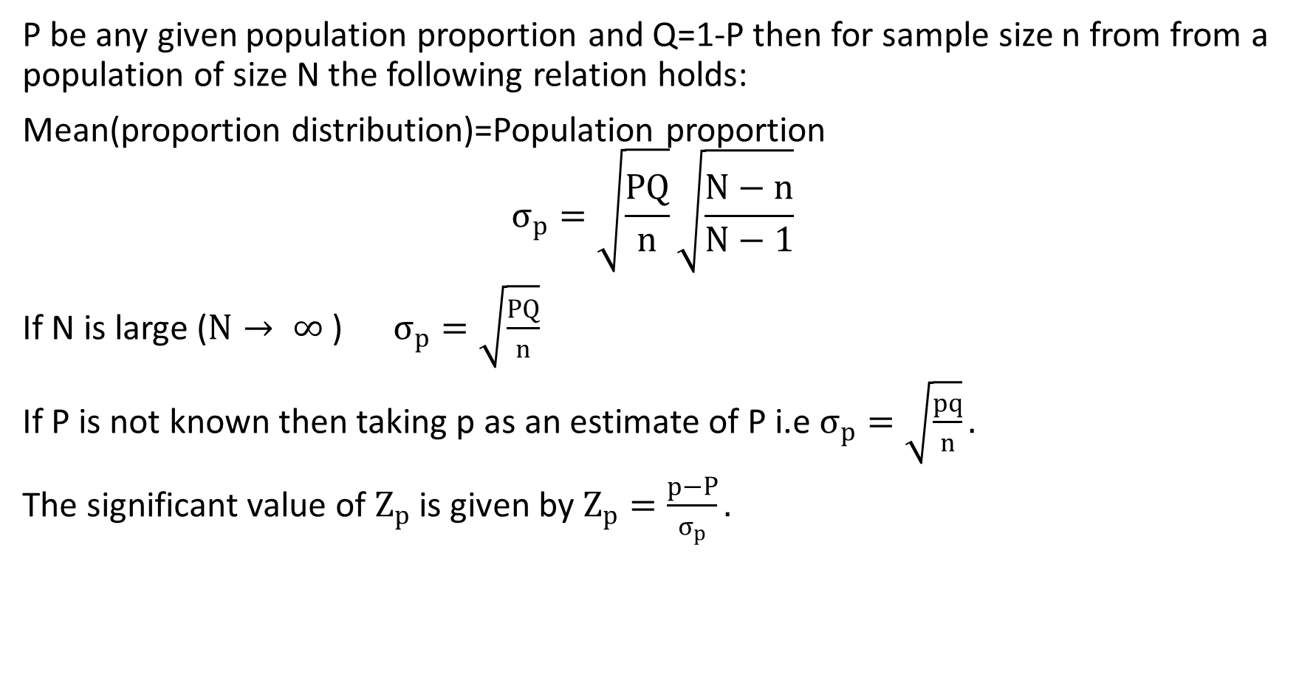





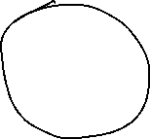


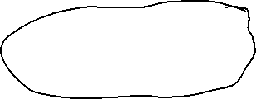








Test of Significance for proportion
P be any given population proportion and Q=1-P then for sample size n from from a population of size N the following relation holds:
Mean(proportion distribution)=Population proportion
$$σ_{p}=\sqrt{\frac{PQ}{n}}\sqrt{\frac{N−n}{N−1}}$$
If N is large ($N→ ∞$ ) $σ_{p}=\sqrt{\frac{PQ}{n}}$
If P is not known then taking p as an estimate of P i.e $σ_{p}=\sqrt{\frac{pq}{n}}.$
The significant value of $Z_{p}$ is given by $Z_{p}=\frac{p−P}{σ_{p}}.$

Slide 29
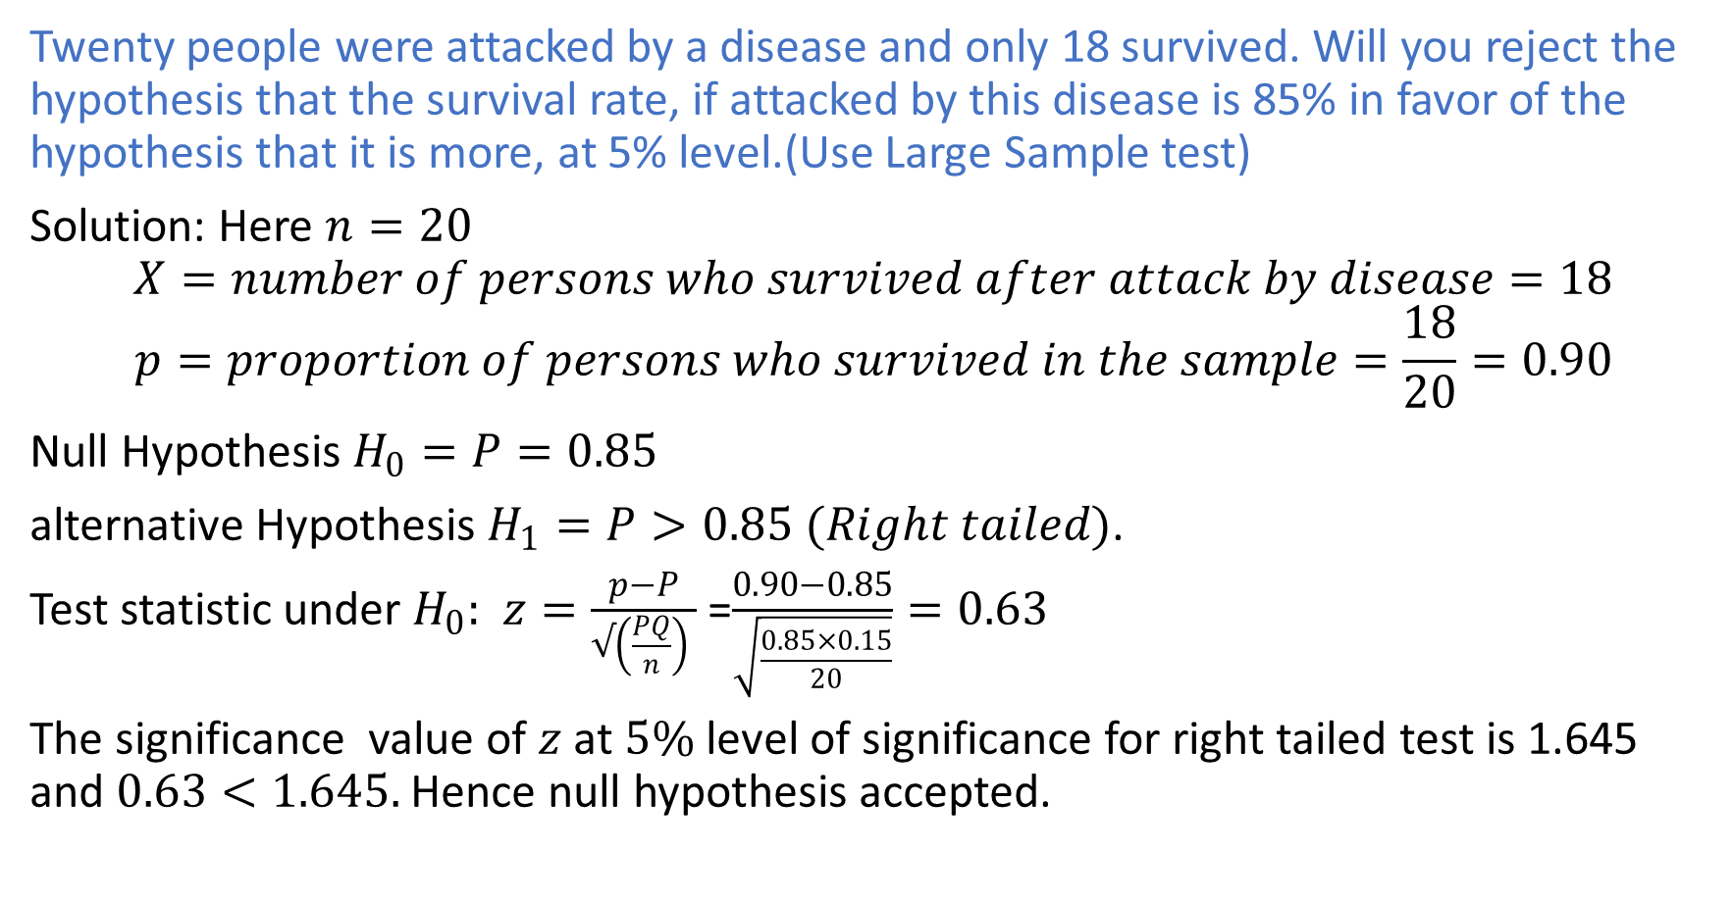
Example 1
Twenty people were attacked by a disease and only 18 survived. Will you reject the hypothesis that the survival rate, if attacked by this disease is 85% in favor of the hypothesis that it is more, at 5% level.(Use Large Sample test)
Solution: Here $n=20$
$$X=number of persons who survived after attack by disease=18$$
$$p=proportion of persons who survived in the sample=\frac{18}{20}=0.90$$
Null Hypothesis $H_{0}=P=0.85$
alternative Hypothesis $H_{1}=P>0.85 (Right tailed)$.
Test statistic under $H_{0}:$ $z=\frac{p−P}{√\left(\frac{PQ}{n}\right) }$ =$\frac{0.90−0.85}{\sqrt{\frac{0.85×0.15}{20}}}=0.63$
The significance value of $z$ at $5\%$ level of significance for right tailed test is 1.645 and $0.63<1.645.$ Hence null hypothesis accepted.

Slide 30
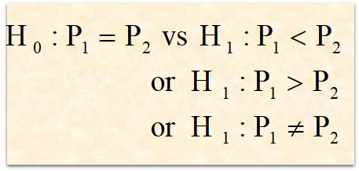
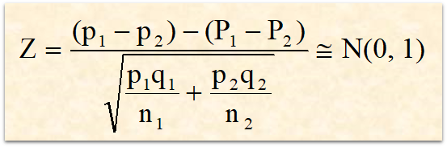



Test of Significance for Difference of Proportion

Slide 31
Example
Two judges have to judge independently whether the defendant is innocent or guilty on the basis of evidence. Lack of sufficient evidence may lead to erroneous decisions like false positive or false negative. Suppose based on evidences, if we are interested in finding whether Judge A has committed more false positivity in the judgement compared to the other Judge. Use α = 0.05.
Judges | No. of defendants (n) | No. of false positives | False positive rate
1 | 3000 | 90 | 3.00%
2 | 2500 | 48 | 1.92%

Slide 32
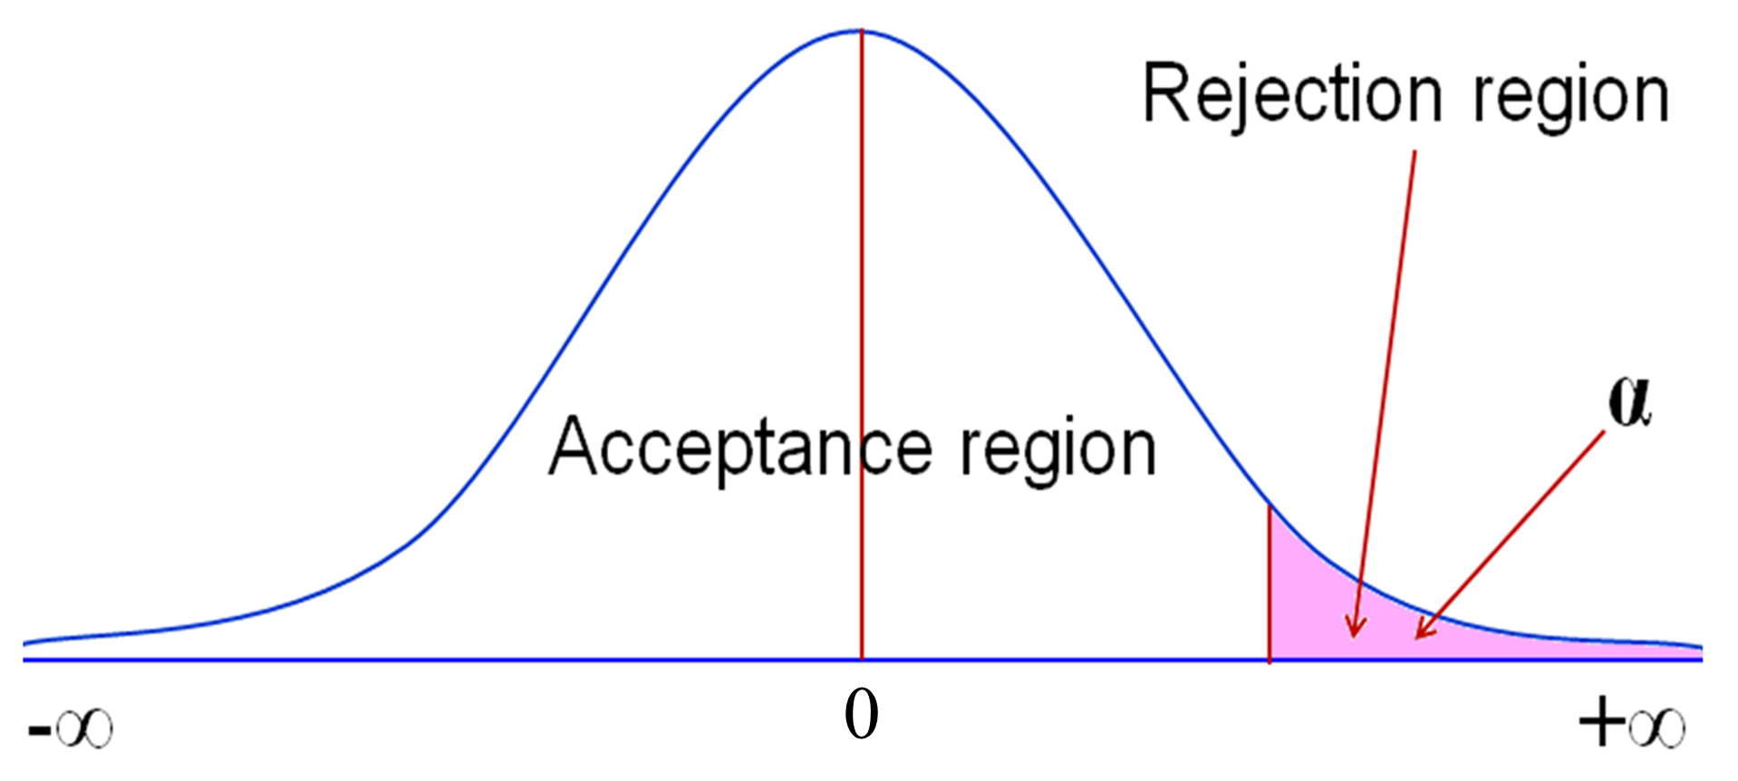
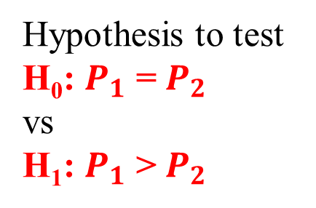
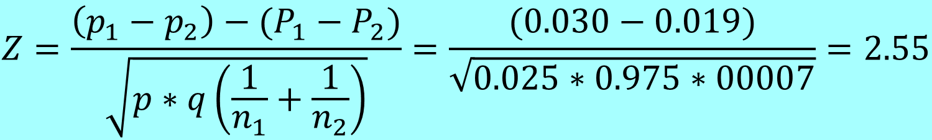
Solution
At 5% (0.05) level of significance with critical value ± 1.645
.
$$Z=\frac{\left(p_{1}−p_{2}\right)−(P_{1}−P_{2})}{\sqrt{p∗q\left(\frac{1}{n_{1}}+\frac{1}{n_{2}}\right)}}=\frac{(0.030−0.019)}{\sqrt{0.025∗0.975∗00007}}=2.55$$
Hypothesis to test
H₀: $P_{1}$ = $P_{2}$
vs
H₁: $P_{1}$ > $P_{2}$
Critical value for α = 0.05 is 1.645. Since Z = 2.55 > 1.645, Reject H_{0,} Don’t reject H₁
P(Z ≥ 2.55) =0.005
Z_{α}= 1.645

Slide 33









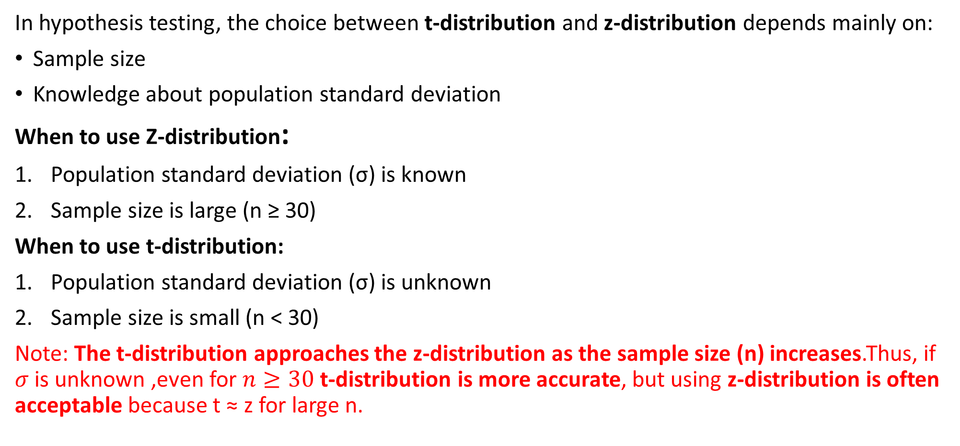






Parametric tests: Student’s t – test
In hypothesis testing, the choice between t-distribution and z-distribution depends mainly on:
Sample size
Knowledge about population standard deviation
When to use Z-distribution:
Population standard deviation (σ) is known
Sample size is large (n ≥ 30)
When to use t-distribution:
Population standard deviation (σ) is unknown
Sample size is small (n < 30)
Note: The t-distribution approaches the z-distribution as the sample size (n) increases.Thus, if $σ$ is unknown ,even for $n≥30$ t-distribution is more accurate, but using z-distribution is often acceptable because t ≈ z for large n.

Slide 34
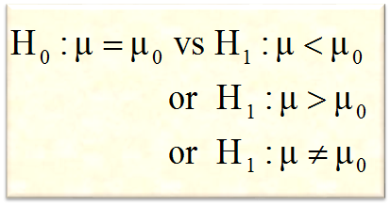
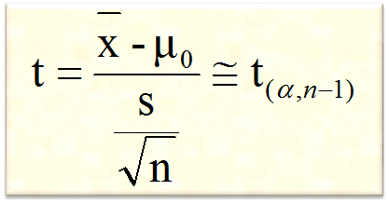

Testing the mean of a single population
.
1
State null and alternative hypothesis
2
Specify the level of significance ‘α’
3
Student’s t-distribution
4
Compute the test statistic
5
Define the critical region/ rejection criteria
6
Conclusion
Note: Rejection criteria may be based on critical value or P-value

Slide 35
Testing the mean of a single population
It is claimed that sports-car owners drive on the average 18580 kms per year. A consumer firm believes that the average milage is probably higher. To check, the consumer firm obtained information from randomly selected 10 sports-car owners that resulted in a sample mean of 17352 kms with a sample standard deviation of 2012 kms. What can be concluded about this claim at
(a) 5% level of significance
(b) 1% level of significance

Slide 36
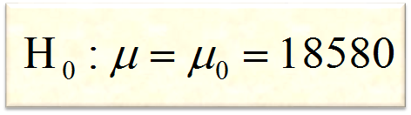
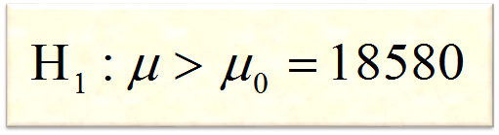
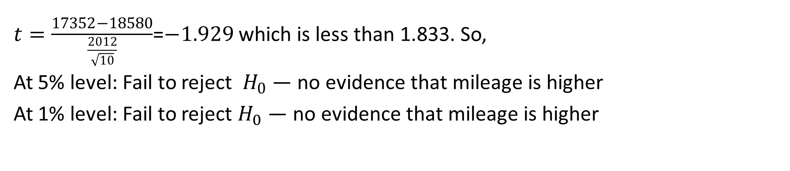
Solution
.
$t=\frac{17352−18580}{\frac{2012}{\sqrt{10}}}$=$−1.929$ which is less than 1.833. So,
At 5% level: Fail to reject $H_{0}$ — no evidence that mileage is higher
At 1% level: Fail to reject $H_{0}$ — no evidence that mileage is higher.
.
At 1% level of significance with critical value 2.262

Slide 37
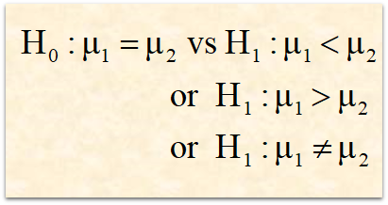
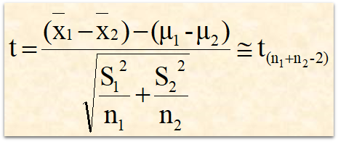
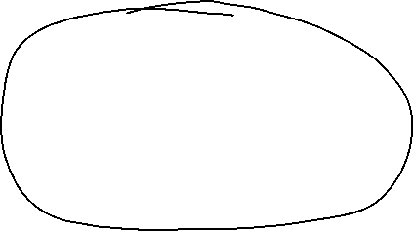
Testing the difference between means of two population (µ₁ – µ₂)
.
Note: If sample sizes are unequal compute pooled SE
Note: Rejection criteria may be based on critical value or P-value

Slide 38










Example
The manager of a courier service believes that packets delivered at the beginning of the month are heavier than those delivered at the end of month. As an experiment, he weighed a random sample of 15 packets at the beginning of the month and found that the mean weight was 5.25 kg. A randomly selected 10 packets at the end of the month had a mean weight of 4.56 kg. It was observed from the past experience that the sample variances are 1.20 kg and 1.15 kg. At 5% level of significance, can it be concluded that the packets delivered at the beginning of the month weigh more? Also find P-value and 95% confidence interval for the difference between the means.

Slide 39
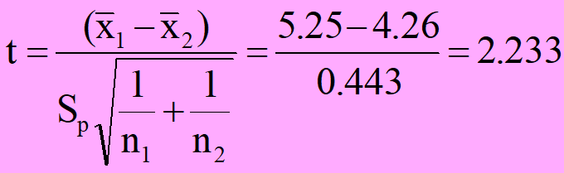
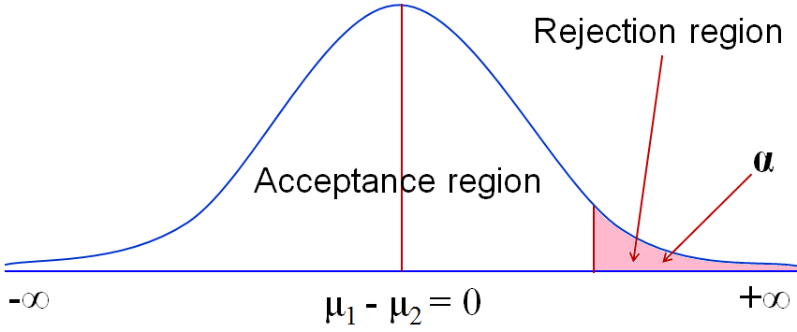




Solution
At 5% (0.05) level of significance with critical value 2.069 (dF=23)
Hypothesis to test
H₀:μ₁ - μ₂ = 0
vs
H₁:μ₁ – μ₂ ≠ 0
$$\text{0.0}1≤P≤\text{0.0}\text{25}$$
t_{α/2}= 2.069
Critical value for α = 0.05 is 1.714. Since t = 2.233 > 2.069, Reject H_{0,} Don’t reject H₁

Slide 40
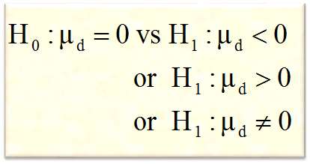
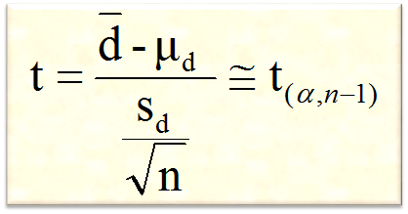
Testing the difference between means of paired observations
1
State null and alternative hypothesis
.
2
Specify the level of significance ‘α’
3
Student’s t-distribution
4
Compute the test statistic
5
Define the critical region/ rejection criteria
Conclusion
But µ_{d} under H₀ will be 0
6
Note: Rejection criteria may be based on critical value or P-value

Slide 41
Example
Subjects | Before (x) | After (y)
1 | 75 | 70
2 | 70 | 77
3 | 46 | 57
4 | 68 | 60
5 | 68 | 79
6 | 43 | 64
7 | 55 | 55
8 | 68 | 77
9 | 77 | 76
.
The HRD manager wishes to see if there has been any change in the ability of trainees after a specific training program. The trainees take a aptitude test before and after training program.
Test at 5% level of significance is there any difference in the test score after training

Slide 42
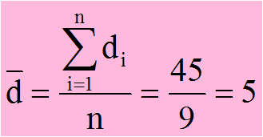
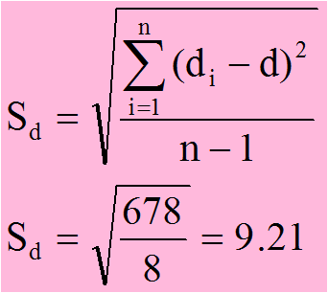
Solution
.
Subjects | Before (x) | After (y) | d = y-x | (d-mean)²
1 | 75 | 70 | -5 | 100
2 | 70 | 77 | 7 | 4
3 | 46 | 57 | 11 | 36
4 | 68 | 60 | -8 | 169
5 | 68 | 79 | 11 | 36
6 | 43 | 64 | 21 | 256
7 | 55 | 55 | 0 | 25
8 | 68 | 77 | 9 | 16
9 | 77 | 76 | -1 | 36
Total |  |  | 45 | 678

Slide 43
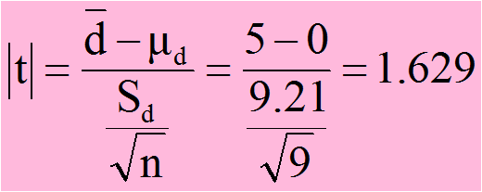

Solution
.
At 5% (0.05) level of significance with critical value is 1.833
Hypothesis to test
H₀:μ_{d} = 0
vs
H₁:μ_{d} > 0
P-value is
Critical value for α = 0.05 is 1.833. Since ǀ t ǀ = 1.629 < 1.833, Don’t reject H₀ & Reject H₁

Slide 44
Chi-square test
The is a statistical test used to compare observed results with expected results. It Chi-Square Test helps to see if there’s a significant difference between them.
Types of Chi-Square Tests:
Chi-Square Test for Goodness of Fit
Used to see if a sample matches a population.
Example: Do dice roll results match the expected equal distribution?
Chi-Square Test for Independence
Used to see if two variables are related or independent
Example: Is there a relationship between gender and subject preference?

Slide 45
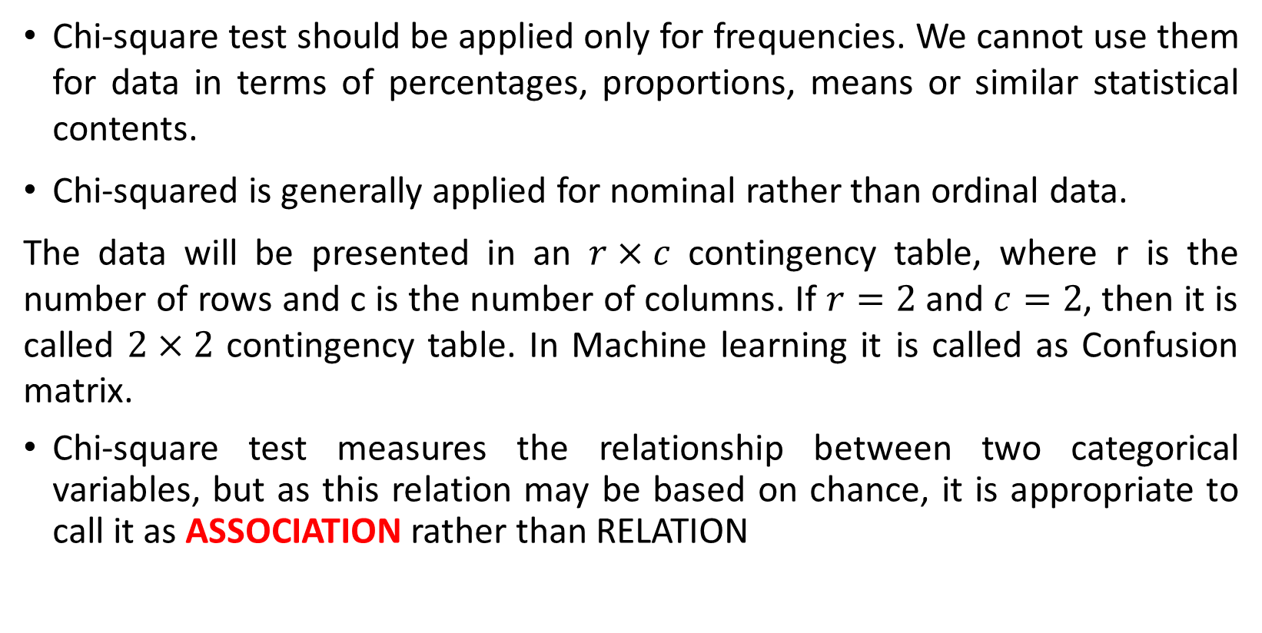
Chi-square test
Chi-square test should be applied only for frequencies. We cannot use them for data in terms of percentages, proportions, means or similar statistical contents.
Chi-squared is generally applied for nominal rather than ordinal data.
The data will be presented in an $r×c$ contingency table, where r is the number of rows and c is the number of columns. If $r=2$ and $c=2$, then it is called $2×2$ contingency table. In Machine learning it is called as Confusion matrix.
Chi-square test measures the relationship between two categorical variables, but as this relation may be based on chance, it is appropriate to call it as ASSOCIATION rather than RELATION

Slide 46

Chi-square Test
.
Hypothesis for testing independence
The hypothesis to be tested for independence will be
H₀: The two categorical variables may be independent (may not be associated)
Observed = Expected
H₁: The two categorical variables may not be independent (may be associated)
Observed ≠ Expected

Slide 47
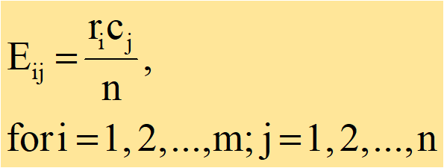
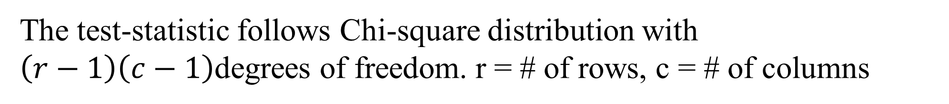

Chi-square Test
.
Procedure for testing independence
To check the independence (no association) between the two categorical variables, the statistical test used is Chi-square test given by
$${\text{}}^{2}=\sum_{i=1}^{m}{\sum_{j=1}^{n}{\frac{{\left(O_{ij}−E_{ij}\right)}^{2}}{E_{ij}}}}$$
The test-statistic follows Chi-square distribution with
$\left(r−1\right)\left(c−1\right)$degrees of freedom. r = # of rows, c = # of columns

Slide 48
Example
An RTO department has observed that, on a highway, a greater number of accidents have taken place in the early hours of the day than other timings and wish to associate the outcome of the accidents with timings. A survey findings show that, of the 400 accident cases studied, 280 had met with accident in the early hours and 99 of them were fatal. Further, those who met with accident in the early hours and died was 80. Does this data indicate any association between the time of accident and fatality of the accident. Use α = 0.05.
Solution:
Hypothesis:
H₀: Timings of accident and its outcome are independent (Not associated)
H₁: Timings of accident and its outcome are dependent (Associated)

Slide 49










Solution
Early hours of accident | Outcome of accident |  | Total
 | Fatal | Non-fatal
Yes | 80 | 200 | 280
No | 19 | 101 | 120
Total | 99 | 301 | 400
.
$$E_{1}=\frac{r_{1}c_{1}}{n}=\frac{280∗99}{400}=69.3$$
$$E_{3}=\frac{r_{2}c_{1}}{n}=\frac{120∗99}{400}=29.7$$
$$E_{4}=\frac{r_{2}c_{2}}{n}=\frac{120∗301}{400}=90.3$$
$$E_{2}=\frac{r_{1}c_{2}}{n}=\frac{280∗301}{400}=210.7$$

Slide 50

Solution
.
Calculation of Chi-square statistic - χ2
Sl No | Observed frequencies (O_{i}) | Expected frequencies (E_{i}) | $$(O_{i}−E_{i})$$ | $${(O_{i}−E_{i})}^{2}$$ | $$\frac{{(O_{i}−E_{i})}^{2}}{E_{i}}$$
1 | 80 | 69.3 | 10.7 | 114.49 | 1.652
2 | 200 | 210.7 | -10.7 | 114.49 | 0.543
3 | 19 | 29.7 | -10.7 | 114.49 | 3.855
4 | 101 | 90.3 | 10.7 | 114.49 | 1.268
Total | 400 | 400 | Chi-square statistic |  | χ² = 7.318

Slide 51

Chi-square Table
.

Slide 52
Conclusion
Hypothesis
.
H₀: Timings of accident and its outcome are independent
(Not associated)
H₁: Timings of accident and its outcome are dependent
(Associated)
χ²= 7.31
df = 1,
Critical value at α = 0.05 is 3.841,
Inference: There may be an association between timings of accident and its outcome

Slide 53
Example
.
In an experiment to study the dependence of hypertension on smoking
habits, the following data were taken on 180 individuals
Hypertension | Non smokers | Moderate smokers | Heavy smokers | Total
Yes | 21 | 36 | 30 | 87
No | 48 | 26 | 19 | 93
Total | 69 | 62 | 49 | 180

Slide 54

Solution
Hypothesis:
.
H₀: Smoking habit and hypertension may be independent (may not be associated)
H₁: Smoking habit and hypertension may not be independent (may be associated)
Calculation of expected frequencies
E₁ = $\frac{{(r}_{1}×c_{1})}{n}$= (87 x 69)/180 = 33.35 E₂ = $\frac{{(r}_{1}×c_{2})}{n}$= (87 x 62)/180 = 29.97
E₃ = $\frac{{(r}_{1}×c_{3})}{n}$= (87 x 49)/180 = 23.68 $E_{4}$ = $\frac{{(r}_{2}×c_{1})}{n}$= (93 x 69)/180 = 35.65
E₅ = $\frac{{(r}_{2}×c_{2})}{n}$= (93 x 62)/180 = 32.03 E₆ = (r₂ x c₃)/n= (93 x 49)/180 = 25.32

Slide 55

Solution
.
Calculation of Chi-square statistic
Sl No | (O_{i}) | (E_{i}) | $$(O_{i}−E_{i})$$ | $${(O_{i}−E_{i})}^{2}$$ | $$\frac{{(O_{i}−E_{i})}^{2}}{E_{i}}$$
1 | 21 | 33.35 | - 12.35 | 152.52 | 4.57
2 | 36 | 29.97 | 6.03 | 36.36 | 1.21
3 | 30 | 23.68 | 6.32 | 39.94 | 1.69
4 | 48 | 35.65 | 12.35 | 152.52 | 4.28
5 | 26 | 32.03 | - 6.03 | 36.36 | 1.14
6 | 19 | 25.32 | - 6.32 | 39.94 | 1.58
Total | 180 | 180 | Chi-square statistic |  | χ² = 14.46

Slide 56
Interpretation
.
Interpretation
H₀: Smoking habit and hypertension may be independent (may not be associated)
H₁: Smoking habit and hypertension may not be independent (may be associated)
χ²= 14.46
df = 2,
Critical value at α = 0.05 is 5.99,
P < 0.001
Inference: There may be an association between smoking and Hypertension

Slide 57

Chi-square test for Goodness-of-fit
A powerful test for testing the significance of the discrepancy between theory and experiment was given by
Karl Pearson known as “Chi-square test for Goodness – of – fit”. It enables to find the deviation of the
experiment from theory is just by chance or is it really due to the inadequacy of the theory to fit the observed data.
If O_{i} (i = 1, 2, …, n) is a set of observed (experimental) Frequencies and E_{i} (i = 1, 2, …, n) is the corresponding
set of expected (theoretical or hypothetical) frequencies, then the Chi-square test statistic is given by
follows Chi-square distribution with n – 1 degree of freedom.

Slide 58
Example:
The following data shows the distribution of digits in numbers chosen at random from a telephone directory. The digits are:
Digits | 0 | 1 | 2 | 3 | 4 | 5 | 6 | 7 | 8 | 9 | Total
f | 1026 | 1107 | 997 | 966 | 1075 | 933 | 1107 | 972 | 954 | 853 | 10000
H₀: The digits occur uniformly frequently in the directory
H₁: The digits do not occur uniformly frequently in the directory

Slide 59

Solution
Under the null hypothesis, the expected frequency for each of the digits 0, 1, …, 9 is 10000 ÷ 10 = 1000. The Chi-square value is
Since χ ² = 58.542 > 16.919 (critical value, df = 9), it can be inferred that the digits are not uniformly distributed.

Slide 60
Example 2
A consultant was employed by a city council to study the pattern of bus arrival and departure at a very busy interstate bus terminus. She collected data from the arrival of 200 buses. Based on the data, the average arrival time was found to be λ = 2.96. She divided the arrivals into 6 categories. Assuming that the arrivals follow Poisson distribution test whether the arrival distribution follows Poisson law. Use α = 0.01.
Solution: The probabilities are to be calculated using Poisson distribution with λ = 2.96 and x = 0, 1, 2, 3, 4, and ≥ 5. The results are as follows:

Slide 61


Solution
The probabilities are to be calculated using Poisson distribution with λ = 2.96 and x = 0, 1, 2, 3, 4, and ≥ 5. The formula for calculating the probability in Poisson distribution is
$$\frac{e^{−λ}λ^{x}}{x!}$$
No. of arrivals | O_{i} | p_{i} | E_{i}
0 | 10 | 0.0524 | 10.48 | 0.0220
1 | 13 | 0.1545 | 30.90 | 10.3693
2 | 45 | 0.2277 | 45.54 | 0.0064
3 | 49 | 0.2238 | 44.76 | 0.4016
4 | 32 | 0.1651 | 33.02 | 0.0315
≥ 5 | 41 | 0.1765 | 35.30 | 0.9204
χ²= |  |  |  | 11.7512
.
Since χ ² = 11.7512 < 13.27 (critical value at df = k-2 = 4), it can be inferred that the arrivals and departures follow Poisson law.

Slide 62

Exercise:
1. Aircrew escape system are powered by a solid propellant. The burning rate of this propellant is an important product characteristic. Specification require that the mean burning rate must be 50 cm/s. From past experience it is known that the population SD is 2 cm/s. A sample of 25 solid propellant were selected randomly to reconfirm the specification stated. The sample mean found was 51.3 cm/s. At 5% level of significance what conclusion should be drawn regarding burning rate?
Hint: µ=50, σ=2, n=25, $\overline{X}$=51.3, H₀: µ=50, H₁: µ≠50, (Two tailed test), Z= $(\overline{X}−$ µ)/ (σ/5), Z_{critical}= ± 1.96
2. A builder claims that solar water heater are installed in 70% of all homes being constructed today in a city. Would you agree with this claim if a random sample of new homes in this city shows that 28 out of 55 had heat pumps installed? What P-value and confidence interval are related in this situation?
Hint: H₀ : p=0.7
H₁: p ≠0.7.
SE=$\sqrt{pq/n}$, choose 95% confidence interval for a two tailed test.
CI= $\hat{p}±Z ×SE$

Slide 63
Chi-square Table
.

Slide 64

Exercise
3. A cigarette manufacturing company claims that its brand A cigarettes outsells its brand B cigarettes by 8%. If it is found that 42 out of a random sample of 200 smokers prefer brand A and 18 out of 100 smokers prefer brand B, test at 5% level of significance, whether 8% difference a valid claim. Also construct 95% CI for (P₁-P₂) and find P-value.
Hint: $n_{1}$=200, $n_{2}$=100, $x_{1}$=42, $x_{2}$=18,
Null hypothesis: $p_{1}$-$p_{2}$=0.08, alternative hypothesis: $p_{1}−p_{2}$ ≠0.08,
Find pooled SE where, p=0.2 and q=0.8, CI=0.03 $±$ 0.096
4. The management of a local health club claims that its members lose on the average 7 kgs or more within 3 months after joining the club. To check this claim, a consumer agency took a random sample of 15 members of this health club and found that they lost an average of 6.26 kgs within the first three months of membership. The sample standard deviation 1.91 kgs. Test at 1% level of significance whether the claim made by management of a local health club is acceptable or not? Also find the P-value of this test.
Hint: α=0.01, one tailed
H0: µ ≥ 7, H1: µ < 7, n=15 (<30 => t-test), dF=15-1=14, $\overline{x}$ = 6.26, s=1.91, p-value= 0.075 (approx value via t table between 0.05 to 0.10 at |t|=1.5, df=14)

Slide 65
Exercise
A taxi company manager is trying to decide whether the use of radial tires instead of regular belted tires improves fuel economy. 12 cars were equipped with radial tires and driven over a prescribed test course. Without changing drivers, the same cars were then equipped with regular belted tires and driven once again over the test course. The gasoline consumption in kilometers per liter was recorded. Assume that the populations are normally distributed
(i) What are the underlying assumptions of Student’s unpaired t-test?
(ii) Based on the data can we conclude that cars equipped with radial tires give better fuel economy than those equipped with belted tires?
(iii) Find P-value.
(iv) Construct 95% CI for difference in means.
(v) What is your inference?
Radial tyres | 4.2 | 5.7 | 2.6 | 7.0 | 6.7 | 4.5 | 5.7 | 5.1 | 7.4 | 6.9 | 6.1 | 3.2
Belted tyres | 4.3 | 3.9 | 5.2 | 5.9 | 5.8 | 4.4 | 4.7 | 5.8 | 5.9 | 3.7 | 4.9 | 4.9

Slide 66
Hints for Qu 5
H₀: There is no difference in fuel economy between radial and regular belted tires.
H₁: Radial tires give better fuel economy than belted tires.
dF=11,
One tailed test with 95% CI
α=0.05 and t(0.05, 11)=1.796
Calculate t using student’s unpaired t-test and compare with 1.796 to accept or reject the null hypothesis.

Slide 67
Exercise 6
Three different analytical tests can be used to determine the impurity level in steel alloys. Each specimen is tested using two procedures and the results are shown in the following tabulation. Is there sufficient evidence to conclude that the three tests give the same mean impurity level using α = 0.01
Hint: H₀: Mean impurity level for all 3 tests are same.
H₁: Mean impurity level for atleast one test is different.
Find mean and variance for both data, and compute the test statistic (t-test), consider df=(15-1)+(6-1)=19.
Specimen | 1 | 2 | 3 | 4 | 5 | 6 | 7 | 8
Test 1 | 1.2 | 1.3 | 1.5 | 1.4 | 1.7 | 1.3 | 1.6
Test 2 | 1.4 | 1.7 | 1.5 | 1.3 | 2.0 | 2.1 | 1.7 | 1.9

Slide 68
Exercise
7. Random samples of 15 and 10 were selected from two thermocouples. The sample means were 315, 303 and sample standard deviations were 3.8, 4.9 respectively.
Construct 95% CI for difference in means
Test whether there is any significant difference in the means of two thermocouples at 5% level of significance
Find the P-value
8. Jaswant is interested in breeding flowers of a certain species. The experimental breeding can result in four possible types of flowers
(a) Megenta flowers with green stigma (MG)
(b) Megenta flowers with red stigma (MR)
(c) Red flowers with green stigma (RG)
(d) Red flowers with red stigma (RR)
According to Mendel’s law, these four kinds of flowers should come out in the ratio of 9 : 3 : 3 : 1. Jaswant found that under her experiment, out of 160 flowers that bloomed the number of flowers with types MG, MR, RG, and RR were 84, 35, 28, and 13. She wants to find out, whether these data are compatible with Mendel’s law. Use α = 0.05.

Slide 69


Exercise 9
Diet-modification Program
Ten individuals have participated
.
Subject | 1 | 2 | 3 | 4 | 5 | 6 | 7 | 8 | 9 | 10
Weight Before | 195 | 213 | 247 | 201 | 187 | 210 | 215 | 246 | 294 | 310
Weight After | 187 | 195 | 221 | 190 | 175 | 197 | 199 | 221 | 278 | 285
Is there sufficient evidence to support claim that this program is effective in reducing weight?
Atssume that the difference between before and after follow normal distribution. Use α = 0.05.

Slide 70

Exercise 10
To assess the length of hospital stay and the type of insurance, data were taken on 70 individuals
.
Type of Insurance | Length of Hospital Stay (days) |  | Total
 | ≤10 | >10
Type 1 | 42 | 3 | 45
Type 2 | 18 | 7 | 25
Total | 60 | 10 | 70
Examine whether Chi-square test can be applied to this data to test the independence between type of insurance and length of hospital stay?

Slide 71

Exercise 11
Three pension plans
.
Independent of job classification
Use α = 0.05
Examine whether there is any association between job classification and pension plan
The opinion of a random sample of 500 employees are shown below
Job Classification | Pension Plan |  |  | Total
 | 1 | 2 | 3
Salaried workers | 166 | 86 | 68 | 320
Hourly workers | 84 | 64 | 32 | 180
Total | 250 | 150 | 100 | 500

Slide 72
Thank You!

